Slide 1

A Fine Balance’: Exploring the Interplay of Reproductive Strategies and Growth Dynamics in Trees Current Progress Report
Xiaomao Wang
March 19 2025

Slide 2
Chapter 1
Roughly finished scrapping Silvics 2 Vols
Masting species: 115; Non-masting species: 45
Need to fill in the blanks with supplementary data sources, especially for the flowering traits

Slide 3
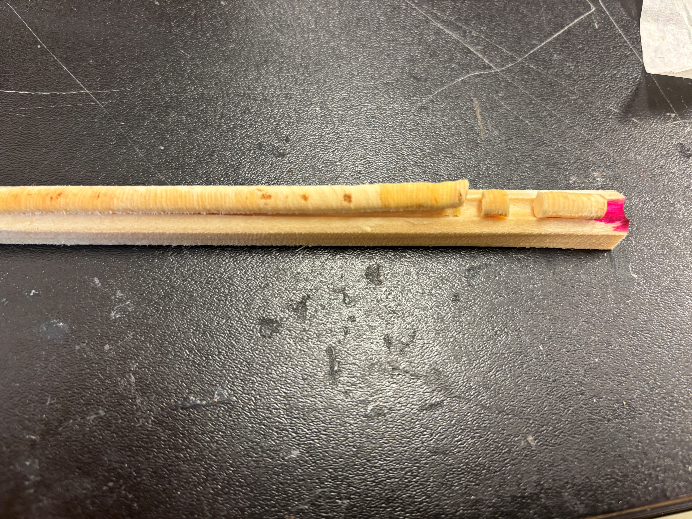
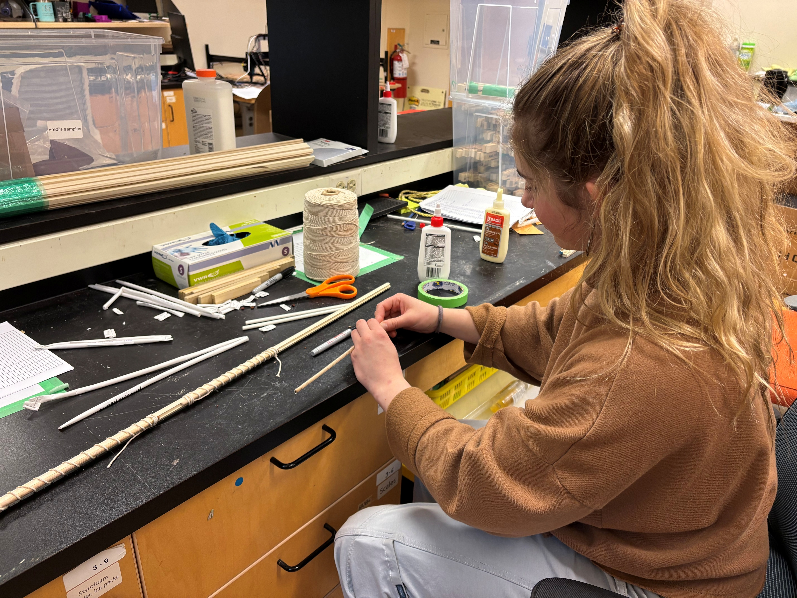

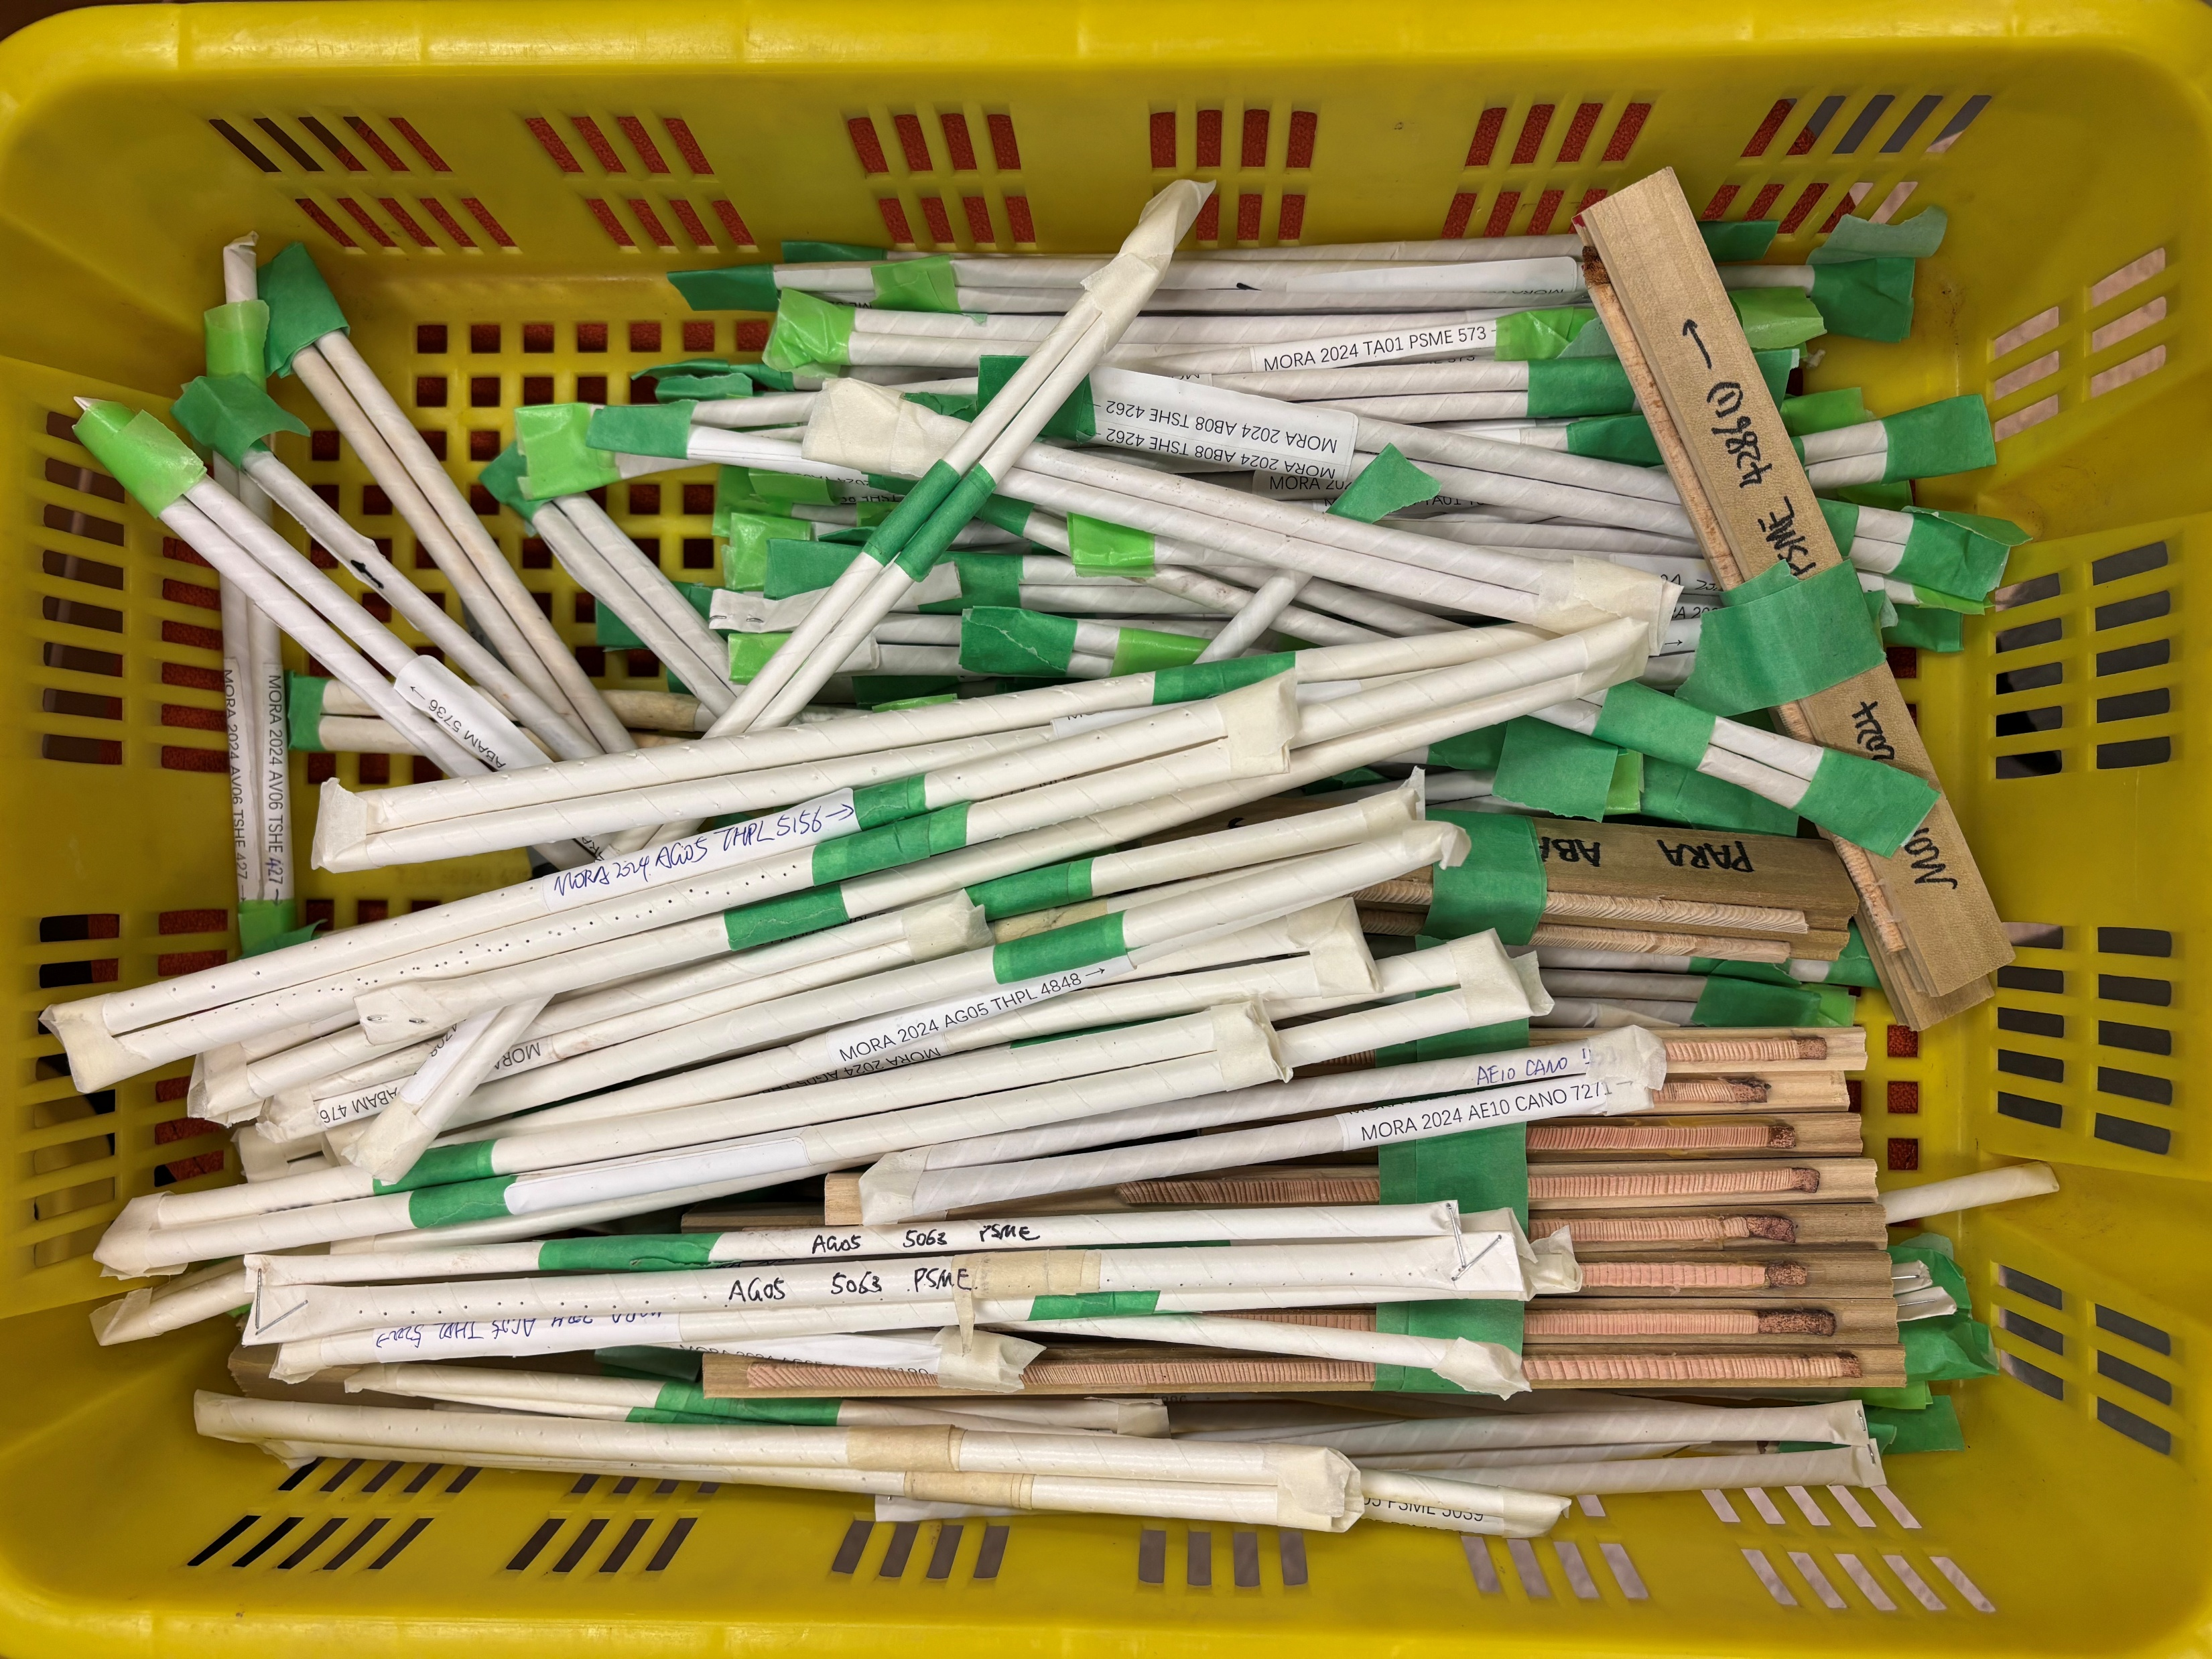
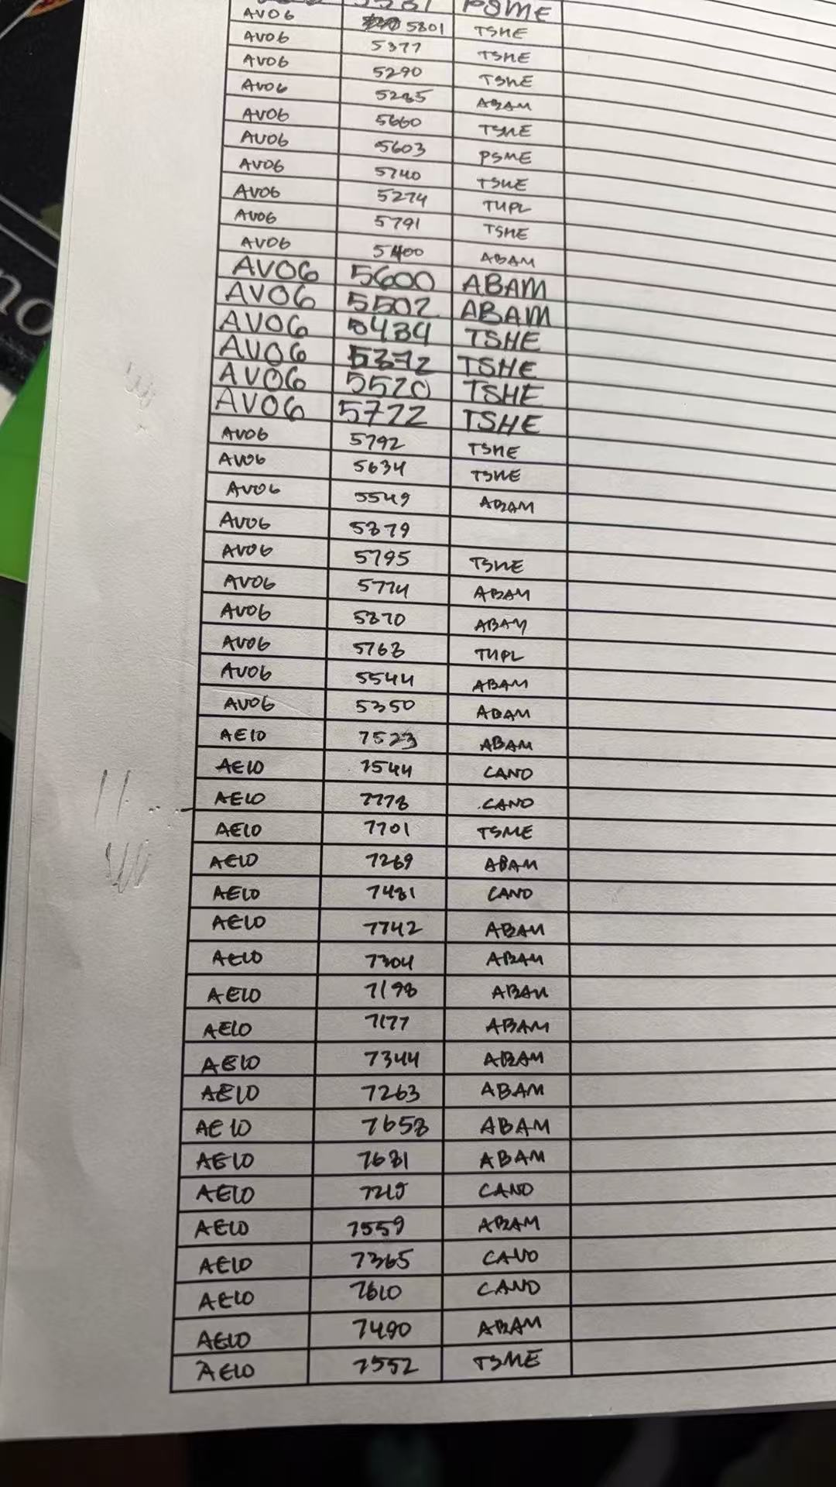
Chapter 2

Slide 4
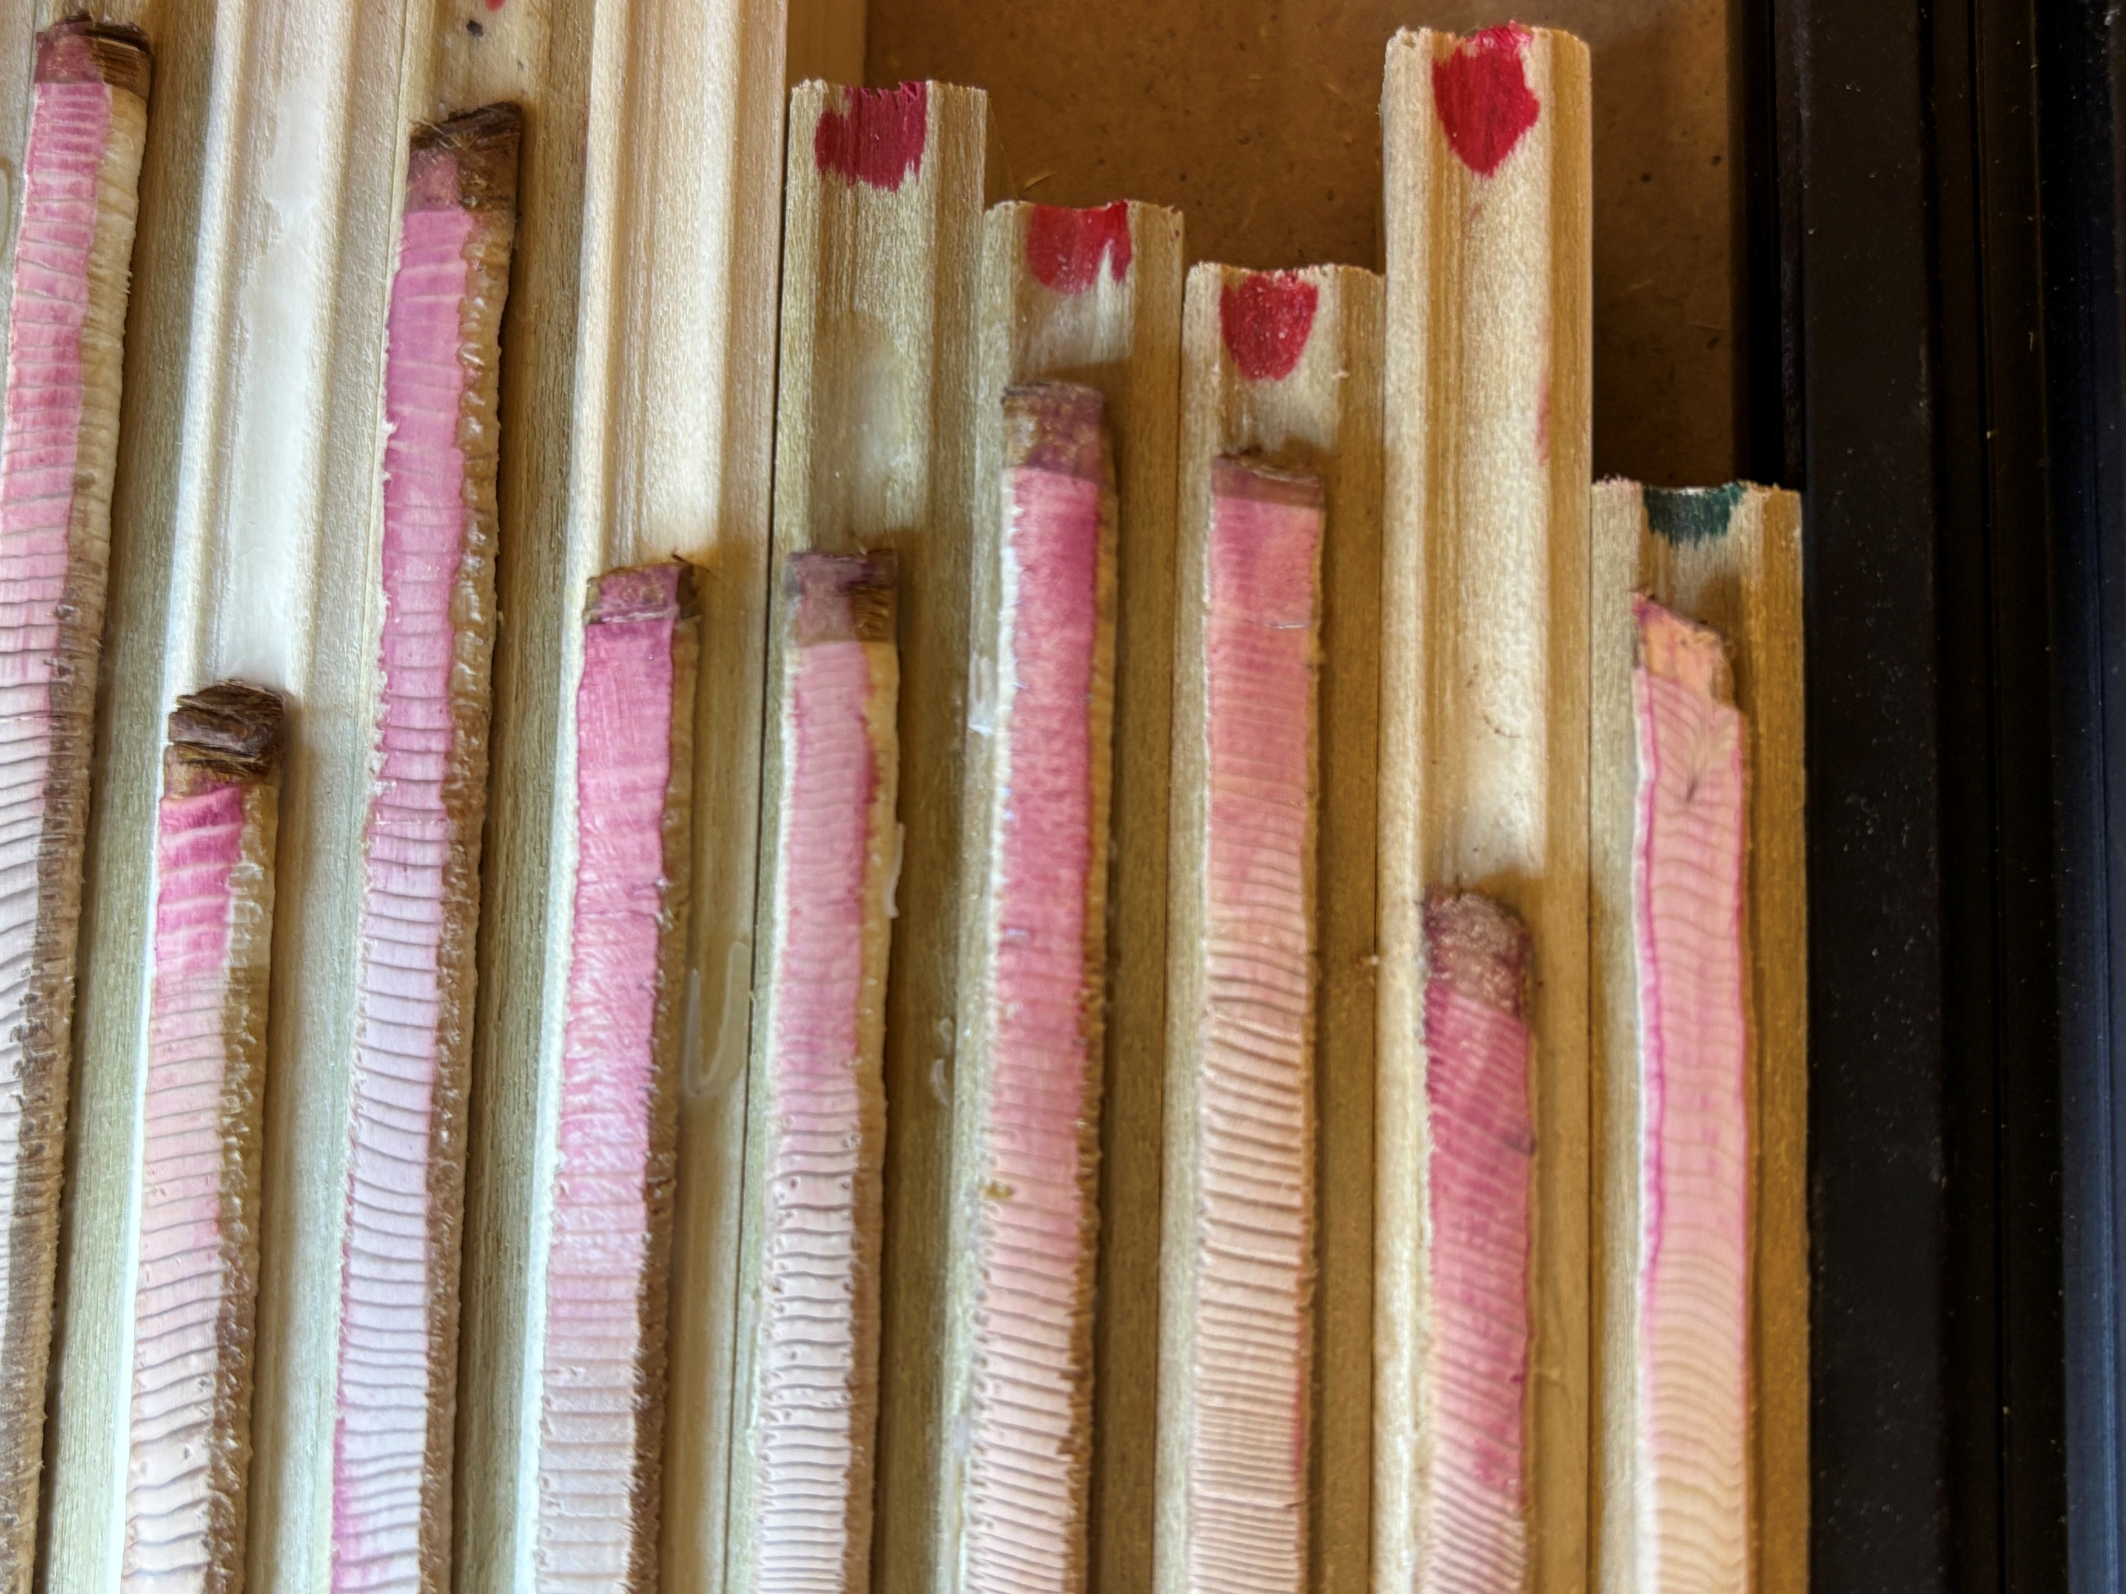
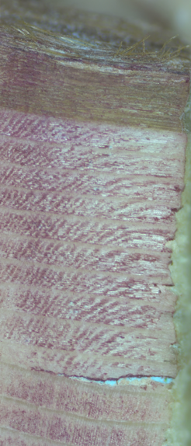
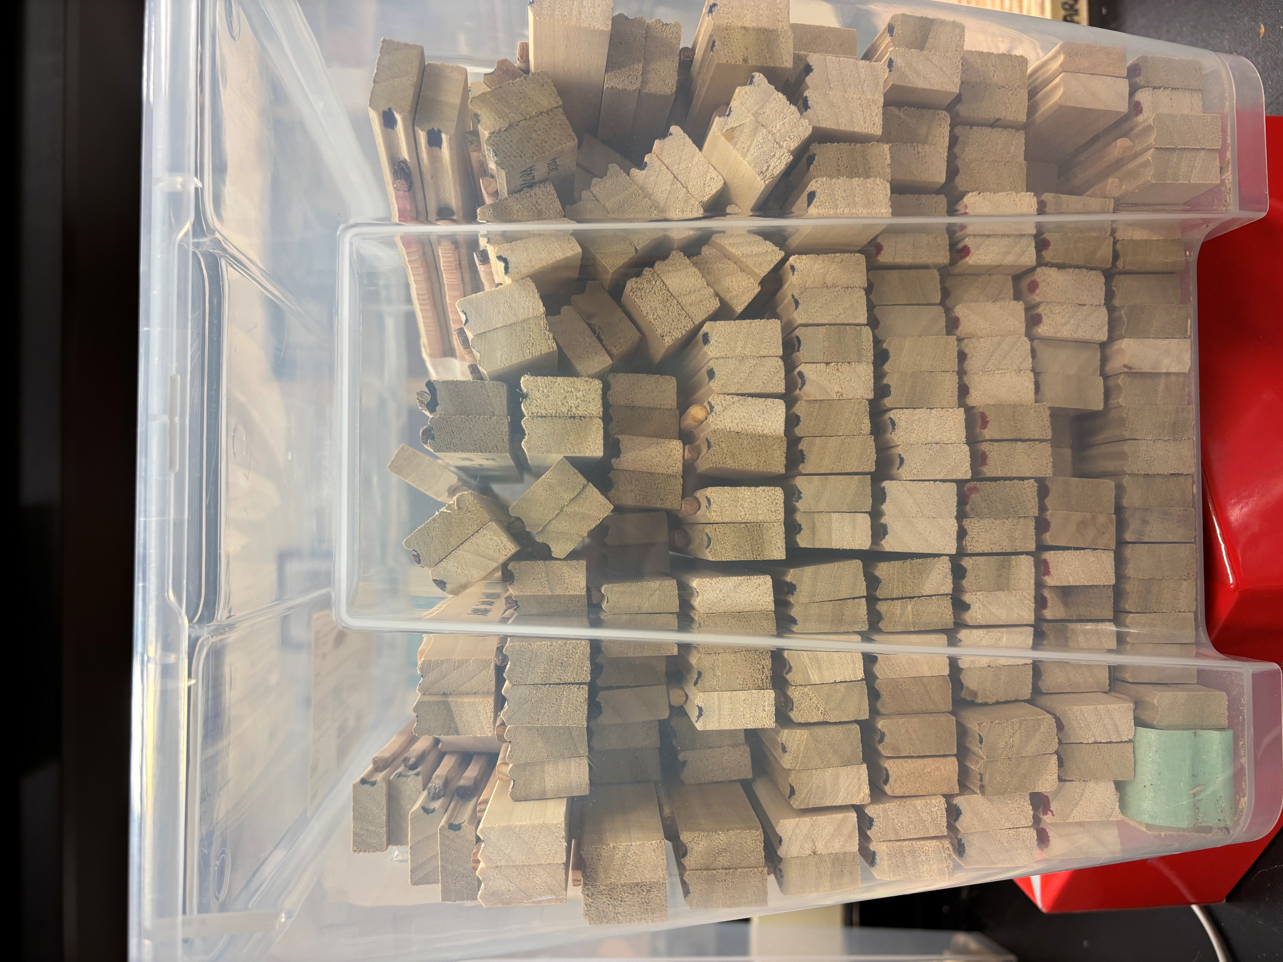
Chapter 2

Slide 5
Chapter 2
Mounted: 317/642
49%
Scanned: 108/642
17%

Slide 6
Plans
Finalize scrapped data with some supplementary sources
Think about the potential models
Continue mounting and sanding at the same time
Continue scanning (10-20 individuals per day)
Check on the scanned tree cores
Get proposal finished and sent out by the end of March
Comprehensive exam during the summer
Collect more tree cores

